Slide 1
SU1 Discussion/Activity Questions & Answers

Slide 2
Activity
Start JupyterLab, open a new notebook and carry out the following tasks:
Carry out simple calculations such as 2 * (3 – 1.5²).
Print the result of the calculation using formatted printing in another cell.
Insert a markdown cell before the cell of step 1 and describe the calculation to be carried out.
Re-run all cells.
Save the notebook on the computer.

Slide 3
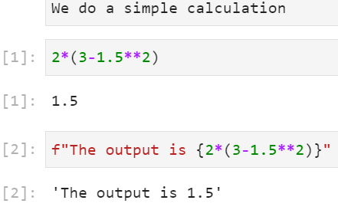
Activity (answers)
Markdown cell
Calculation
Print

Slide 4
Discussion
What are the advantages of using JupyterLab for data analytics tasks in comparison to Atom?
What is the optimal size of a chuck of code in a single cell?

Slide 5
Discussion (answers)
What are the advantages of using JupyterLab for data analytics tasks in comparison to Atom?
Create and run code in one environment
What is the optimal size of a chuck of code in a single cell
One function
Not more than 3 lines

Slide 6
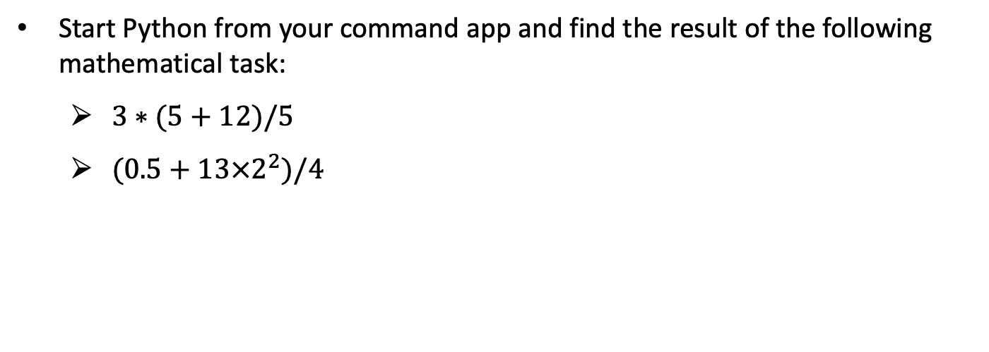
Activity
Start Python from your command app and find the result of the following mathematical task:
$3∗(5+12)/5$
$(0.5+13×2^{2})/4$

Slide 7
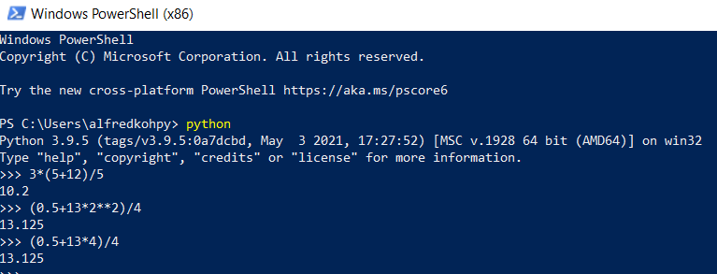
Activity (Answer)
Start Python from your command app and find the result of the following mathematical task:
$3∗(5+12)/5$
$(0.5+13×2^{2})/4$

Slide 8
Discussion
How do we carry out mathematical calculations in Python? How similar is it in comparison to formulas written on paper?
What are the rules that a Python variable name must follow?
What is the difference between an integer and a float variable?

Slide 9
Discussion (Answer)
How do we carry out mathematical calculations in Python? How similar is it in comparison to formulas written on paper?
Symbols differ (i.e., ** for exponents)
Same order of operations (i.e., paranthesis takes priority)
What are the rules that a Python variable name must follow?
Cannot start with a number
What is the difference between an integer and a float variable?
Integer without decimal point

Slide 10
SU2 Discussion Questions & Answers

Slide 11
Discussion
What are the components of a built-in function or method, and where can we get those information before applying them in our program?
Can we avoid the use of functions or methods and write such routines by ourselves?

Slide 12
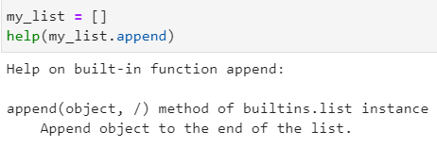
Discussion (answer)
What are the components of a built-in function or method, and where can we get those information before applying them in our program?
Use the help() command
Can we avoid the use of functions or methods and write such routines by ourselves?
user-written functions

Slide 13
Discussion
When is it appropriate for us to write a user-defined function?

Slide 14
Discussion (answers)
When is it appropriate for us to write a user-defined function?
E.g., break very complex codes into chunks

Slide 15
SU3 Discussion Questions & Answers

Slide 16
Discussion
When is it more sensible to use arrays instead of tuples, lists, or dictionaries? And when is it vice versa?
Why do some NumPy functions require the whole axis or array for its process and why some of them do not?

Slide 17
Discussion (answer)
When is it more sensible to use arrays instead of tuples, lists, or dictionaries? And when is it vice versa?
Use arrays when we have multi-dimensional objects
Why do some NumPy functions require the whole axis of array for its process and why some of them do not?
Depends on what we are calculating. E.g., mean of a column vs the mean of an array

Slide 18
Discussion
What are the additional matplotlib functions that can help us to improve the visualisation of our charts?
Name some situations in which a line chart, or a histogram, or a scatter plot is more suitable than other plot types for data visualisation.

Slide 19
Discussion (answers)
What are the additional matplotlib functions that can help us to improve the visualisation of our charts?
E.g., type of markers used, labels rotated, etc.
Name some situations in which a line chart, or a histogram, or a scatter plot is more suitable than other plot types for data visualisation.
Line chart: track changes in a variable over time
Histogram: interested only in a variable’s distribution
Scatter plot: relationship between two variables

Slide 20
SU4 Discussion Questions & Answers

Slide 21
Discussion
What are the main differences between a dataset (or pandas DataFrames) and an array (or NumPy array)?
How different are the outputs of a DataFrame resulting from the different printing functions in Python? Which one is most/least preferrable when using JupyterLab or jupyter notebook as our programming environment?

Slide 22
Discussion (Answers)
What are the main differences between a dataset (or pandas DataFrames) and an array (or NumPy array)?
Pandas DataFrames has headers and row labels, but not numpy array
How different are the outputs of a DataFrame resulting from the different printing functions in Python? Which one is most/least preferrable when using JupyterLab as our programming environment?
We see the dimensions at once using display(); more convenient than print()

Slide 23
Discussion
Name situations where we would need to select data from a DataFrame.
How different are the syntaxes between row and column selections.

Slide 24
Discussion
Name situations where we would need to select data from a DataFrame.
For instance, we only want part of a dataset for our project
How different are the syntaxes between row and column selections
Row selections has no natural row index labels after loading csv file, whereas column does
However, can convert row values into labels by using df.set_index(“column name”, inplace = True)

Slide 25
Discussion
What happens to the bin edges in the discretisation process using the cut() function?
When is log-transformation/normalisation/standardisation necessary? What is the main difference between normalisation and standardization?

Slide 26
Discussion (answers)
What happens to the bin edges in the discretisation process using the cut() function?
Left edge of first bin not included by default
Rightmost edge of bin is included by default
When is log-transformation/normalisation/standardisation necessary? What is the main difference between normalisation and standardization?
Log-transform: reduce influence of outliers
Normalization and standardization: variables on different scales

Slide 27
SU5 Discussion Questions & Answers

Slide 28
Discussion
Can we use the .replace() method to reduce the number of categories of a numeric categorical variable instead of discretisation?
If the target variable is categorical and binary, there must be two dummy variables resulting from the dummy-variable-conversion. Which dummy variable shall we choose for the scikit-learn algorithm?

Slide 29
Discussion (Answers)
Can we use the .replace() method to reduce the number of categories of a numeric categorical variable instead of discretisation?
replace can be used for a numeric categorical variable
If the target variable is categorical and binary, there must be two dummy variables resulting from the dummy-variable-conversion. Which dummy variable shall we choose for the scikit-learn algorithm?
Depends on the goal of your algorithm
Which target do you want to predict?

Slide 30
Discussion
Name all the main differences between classification trees and regression trees.
How do we judge a model with low prediction accuracy for testing data but high accuracy for training data?
Is it possible for a model to have low prediction accuracy for training data, but high accuracy for testing data?

Slide 31
Discussion (answers)
Name all the main differences between classification trees and regression trees.
Classification: binary / categorical target; regression: continuous target
Classification: confusion matrix; regression: gini entropy
How do we judge a model with low prediction accuracy for testing data but high accuracy for training data?
Overfit model; model learnt relationships specific to training data
Is it possible for a model to have low prediction accuracy for training data, but high accuracy for testing data?
Usually no; if it happens, your dataset might be too small
https://www.ibm.com/cloud/learn/underfitting

Slide 32
SU6 Discussion Questions & Answers

Slide 33
Discussion
Why is .csv file a good medium of data storage in comparison to other formats?
What are the components of the SQLite3 package which regulate the “communication” between a Python program and a database?

Slide 34
Discussion (answer)
Why is .csv file a good medium of data storage in comparison to other formats?
Save memory
What are the components of the SQLite3 package which regulate the “communication” between a Python program and a database?
Connection: open a connection from Python to the database
Cursor object: execute commands on the database

